Slide 1
How to write an ideal tutorial?
Sidra Tahir

Slide 2
1. PINPOINT THE PROBLEM YOU ARE GOING TO SOLVE
If you are writing a tutorial, it is because you have noticed a problem.
You have noticed that your audience is at point A and you need to get them to point B, or because they have come to you and asked you to help them get to point B.
From the beginning of the creation process, it is important that you maintain a clear idea of exactly what problem you are trying to crack and focus on solving it.
Focusing on the problem first helps you to organize your thoughts.
Your audience comes into the tutorial knowing exactly the problem that will be solved and whether the problem applies to them.

Slide 3
2. IDENTIFY YOUR AUDIENCE
After you identify the problem you want to solve, ask yourself who are you writing this tutorial for.
Are you writing this for Aunt Phyllis who just got her first computer? Or are you writing for Joe User who wants to become Joe Power User?
Some tutorials are for the general public and need to be written for the lowest common denominator, meaning everything starts at step zero.
This is not a winning formula for every tutorial, however.
If your target audience should already be familiar with the topic that you will be covering in the tutorial, then there is nothing wrong with starting step three or four and providing a general overview of earlier steps in the tutorial introduction with links to more specific information, if needed.

Slide 4
3. DEFINE WHAT SUCCESS LOOKS LIKE
Once you identify the problem and target audience, you have to tell your audience what success looks like.
You will be completing this sentence for your audience, “At the completion of this tutorial, you will be able to…”
This step is usually a pretty easy one if you have done steps one and two. If you are addressing a specific problem, it is easy for your audience to know whether that problem is solved at the end of the tutorial.
Circling back to the Google example, if you are addressing the search syntax problem, your audience will know that they successfully completed the tutorial when they enter searches into Google and get valuable results, spending less time sifting through inapplicable links.
If you are addressing the problem, “I will teach you everything you need to know about Google,” it is very difficult to measure success because the problem is incredibly subjective.

Slide 5
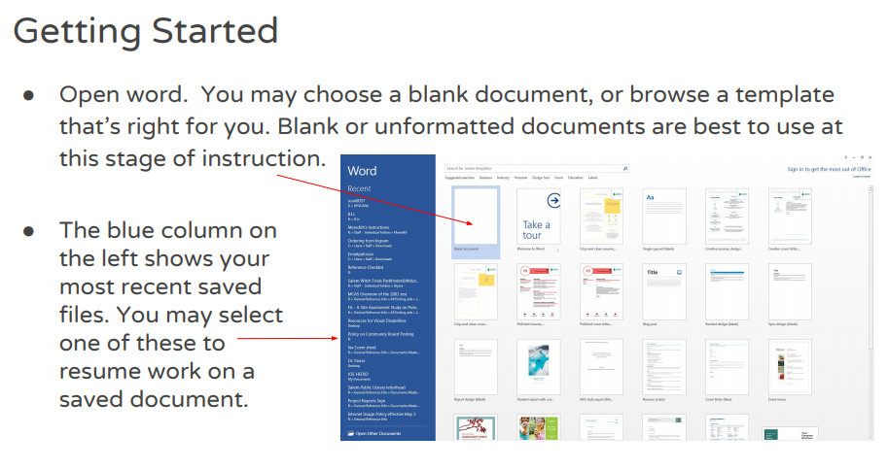

Slide 6
4. DECIDE THE FORMAT OF YOUR TUTORIAL
Once you decide on the problem you are solving and who you are solving it for, you need to decide how to present it.
Would a textual blog post be a good way to present the information? Or should you post a video tutorial?
Would a screen capture/simulation be appropriate? Sometimes your resources and capabilities limit this decision.
With that being said, if a video would really be the best format for presenting the information but you do not have the capability to shoot the video, consider establishing a partnership with a videographer to get the best possible tutorial out to your audience.
Same goes with the screen capture/simulation option. There are tools out there that can simplify the process and make a more professional-looking simulation video. Presenting tutorial information in an inappropriate format undermines the instructional integrity of your project and could hurt your credibility with your audience.

Slide 7
5. MAKE IT USER-FRIENDLY
Once you know the format you are going to use to present your tutorial, make it work for your audience.
Following writing and presentation standards is incredibly important. You do not want to lose your audience because of easily avoided editing mistakes, like typos or poor word usage.
If you are presenting in a blog post, do not present a wall of words. Short paragraphs with plenty of pertinent images, graphics, and white space motivate the reader to keep going.
While graphic use helps draw in the audience, do not overdo it and turn off the reader by inundating them with images, graphics, and crazy fonts. Overstimulating them is just as damaging as boring them.
If you decide to create a video tutorial, do everything you can to ensure that the video is watchable. Edit the audio and voice over to make it as appealing to the listener as possible. Whatever you do, do not distract the audience from the goal of the tutorial, which is to solve the problem identified at step one.

Slide 8
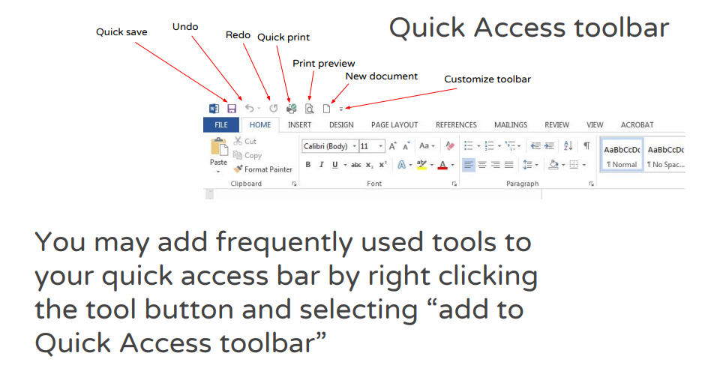

Slide 9
6. ELICIT FEEDBACK FROM YOUR AUDIENCE
Once your tutorial goes live and you have an audience, follow up with them and find out their thoughts about the tutorial.
One of the most common problems with tutorials written by non-training professionals is that they are often written to one learning style (usually the author’s learning style.)
Sending a brief survey to your audience post-tutorial could help you to identify that your tutorial is missing elements that appeal to visual learners, or is missing audio to draw in your aural learners.
While it is incredibly unlikely that 100% of your tutorial participants will be happy with the tutorial, you will notice themes in the feedback that will help you to improve the tutorial.

Slide 10
7. DON’T FORGET ABOUT YOUR TUTORIAL
The final step in the tutorial creation process should be to keep improving your tutorial.
Set a calendar reminder to go back and revisit your tutorial quarterly to make sure that the information is still correct, and to add anything new that you have learned in the mean time.
If you are writing the tutorial to answer an ongoing problem, many times that problem is timeless and you cannot predict when someone will access your tutorial.
You do not want to ruin your integrity with your audience by allowing your tutorial to become dated if someone stumbles onto your tutorial six months after you initially posted it.

Slide 11
Assignment
Example: https://www.youtube.com/watch?v=ME_F9yypzsw
Example:
https://www.noblenet.org/salem/reference/wp-content/uploads/2017/01/word.pdf
Topic: you can decide.
Group assignment
Tools: MS Word, Power Point.
Deadline: 23rd Nov,2020

Slide 12
Brain Storming Session

